Slide 1

Flagship Investment Projects:
From Pipeline to Implementation

Slide 2

Ukraine's Flagship Projects
The Government of Ukraine has identified a portfolio of flagship projects to consolidate the efforts of government, business, and international partners around the implementation of the largest and most transformative investment initiatives
These projects are designed to accelerate economic recovery, infrastructure modernization, and private sector investment

Slide 3




Selection Criteria
Project budget exceeding $200 million
Investment readiness at Pre-Feasibility Study stage or above
Realistic implementation timeline
Alignment with Ukraine's strategic priorities

Slide 4


Flagship Project Selection Process
Phase I
Phase II
Long List
Short List
54 projects
18 projects
Total budget:
Total budget:
$114.9 Bn
$64.7 Bn

Slide 5

Flagship Projects Portfolio by Sector
18 projects | $64.7 billion
Sector
Projects
Budget, USD bn
Energy
7
$51.0
Industry
4
$2.9
Critical Raw Materials
3
$1.2
IT & Communications
1
$6.0
Transport
2
$3.0
Housing
1
$0.5

Slide 6







Energy – 7 projects, $51 Bn
Khmelnytskyi NPP.
Units 3, 4 & 5, 6 (4.4 gw)
$22.1 bn
Poltava wind farm
650 MW onshore wind farm
$1.4 bn
Unconventional gas deposits of the dnipro-donetsk basin
$18.3 bn
Project blue
650 MW CCGT power plant
$1.2 bn
Smart grids for ukraine
Modular energy storage systems
$5.0 bn
Plakhtiyivka energy complex
460 MW wind + 460 MW solar
+ 200 MWH BESS
$1.1 bn
Construction of kaniv pumped storage power plant (1 GW)
$2.0 bn

Slide 7







Industry & Critical Raw Materials – 7 projects, $4.1 Bn
New EAF & CCM at Kamet Steel low-carbon steel slab
$1.1 bn
BGV spherical graphite project
Battery-grade spherical graphite
$0.4 bn
Green EAF-based flat steel
1+ Mt low-carbon production
$1.0 bn
Float glass plant
& coated glass manufacturing
$0.3 bn
Production of DR-grade pellets
For DRI steelmaking
$0.5 bn
Ukrainian titanium cluster
Integrated titanium value chain
$0.2 bn
Uranium ore mining expansion
1.5 Mt ore production per year
$0.5 bn

Slide 8




ITC, Transport & Housing – 4 projects, $9.5 Bn
AI & HPC data center – Ukraine superpower hub
Up to 500 mw data center capacity
$6.0 bn
Western border connectivity
program Ppp road corridors to the EU
$2.6 bn
Social rental housing
52 residential buildings
6,500 families
$0.5 bn
Lviv airport cluster
+ 1 regional airport
Airport modernization under PPP
$0.5 bn

Slide 9
More Investment Opportunities – Invest Guide 3.0
377 investment opportunities
347 commercial projects
30 investment funds
Total budget:
Required financing
$77.2 billion
$61.6 billion

Slide 10
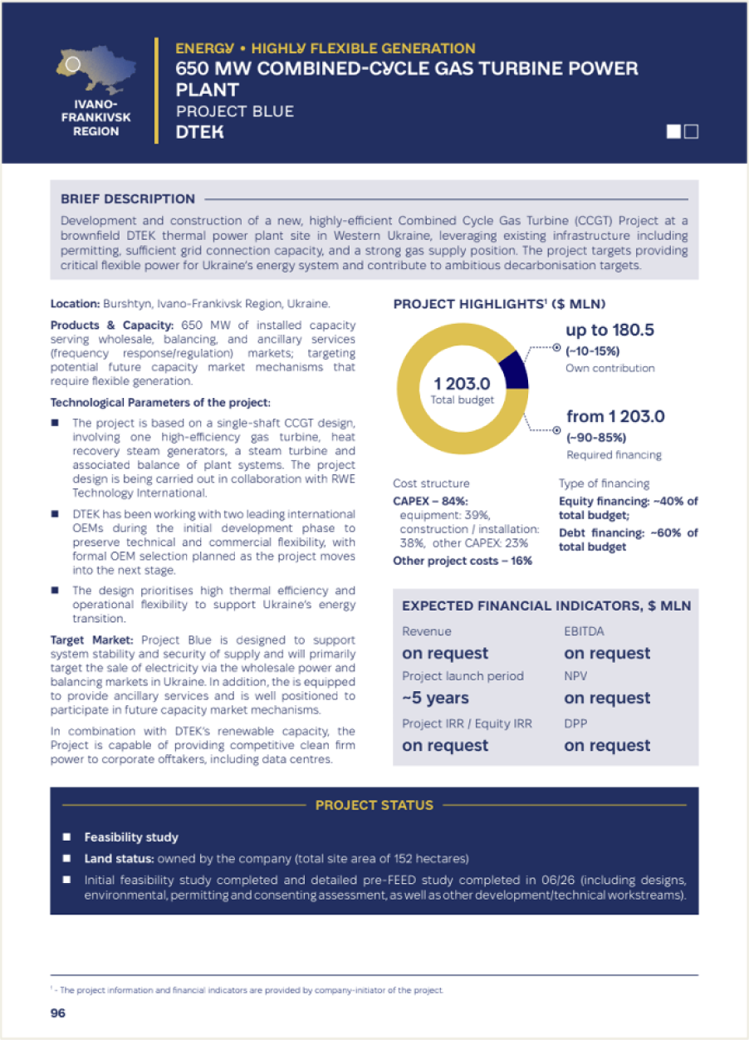
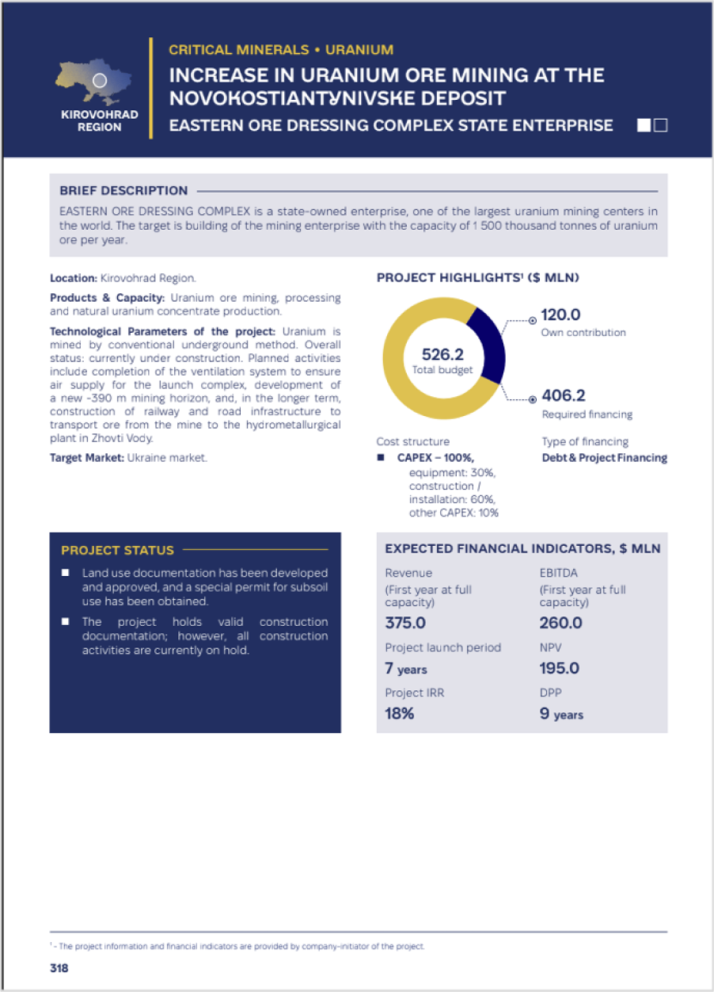
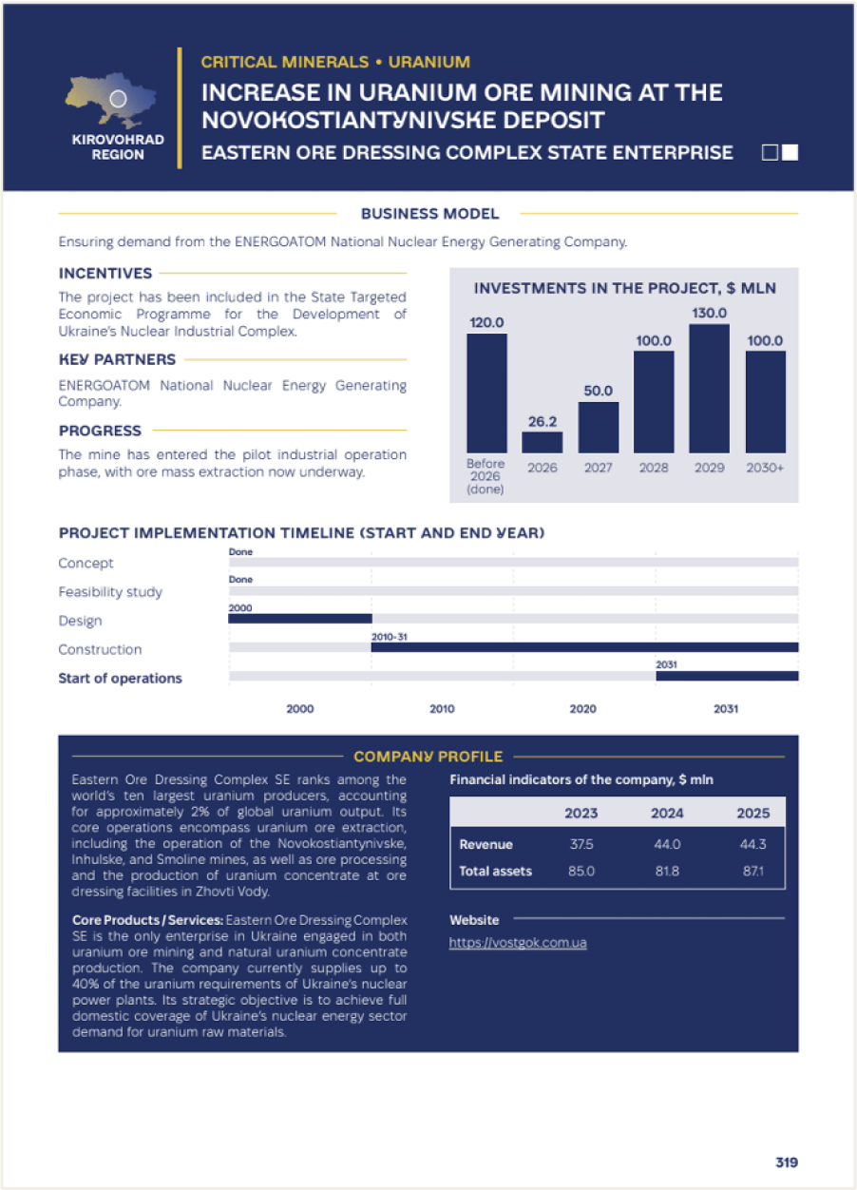
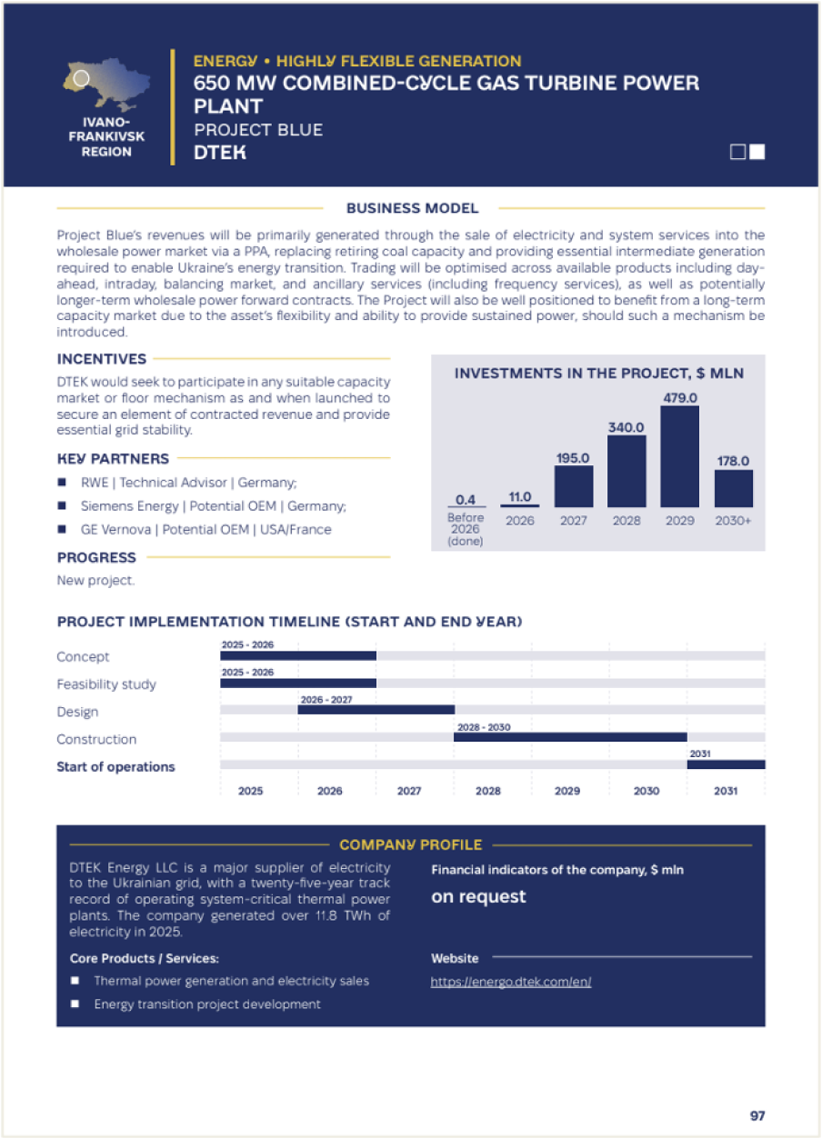

Flagship Projects

Slide 11
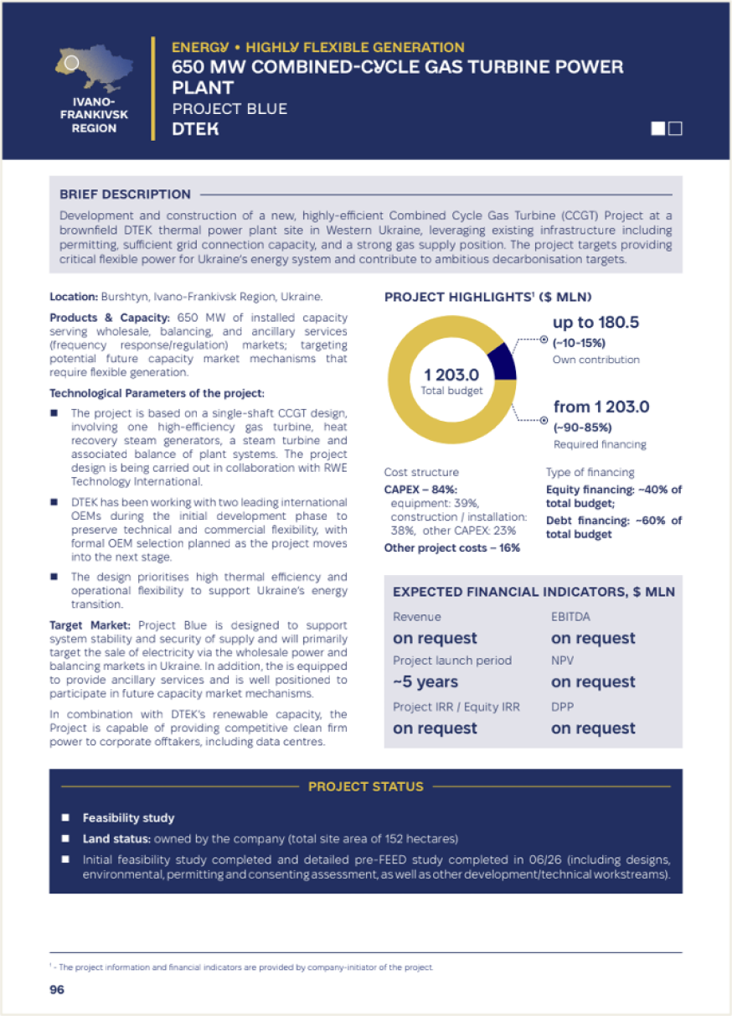

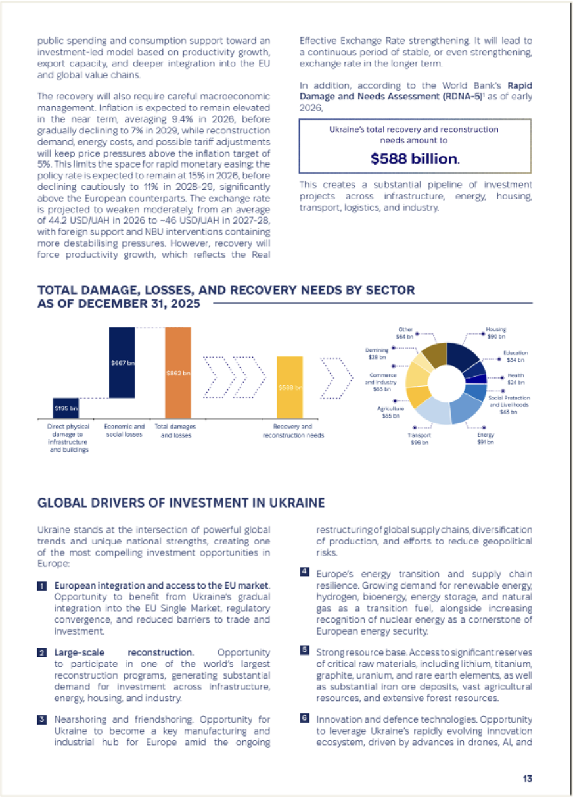
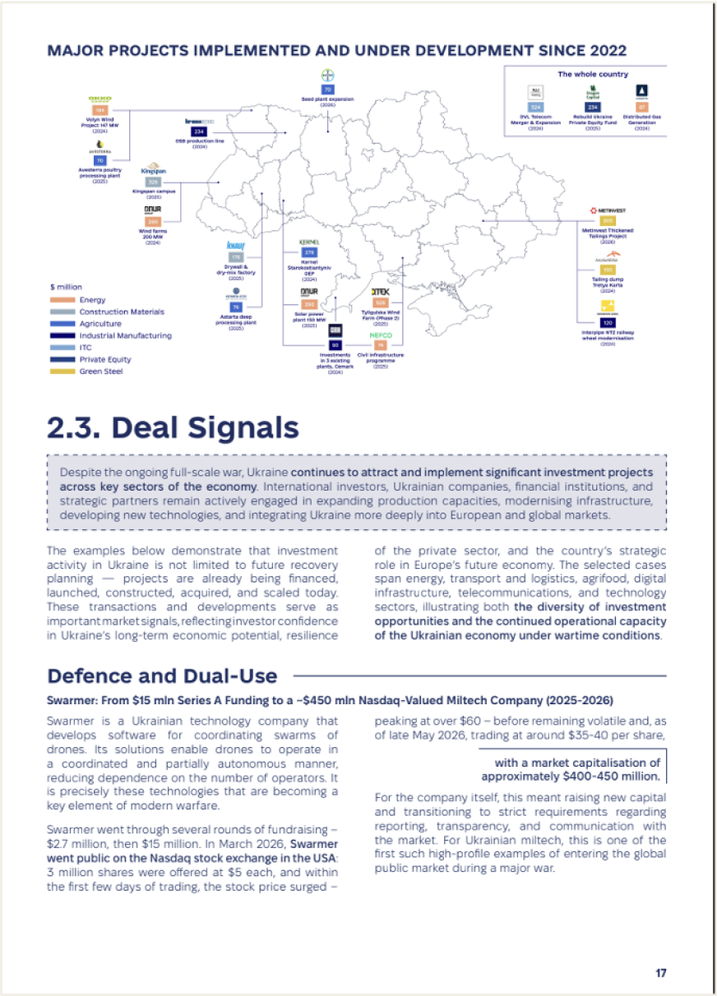


Investment Guide

